Slide 1

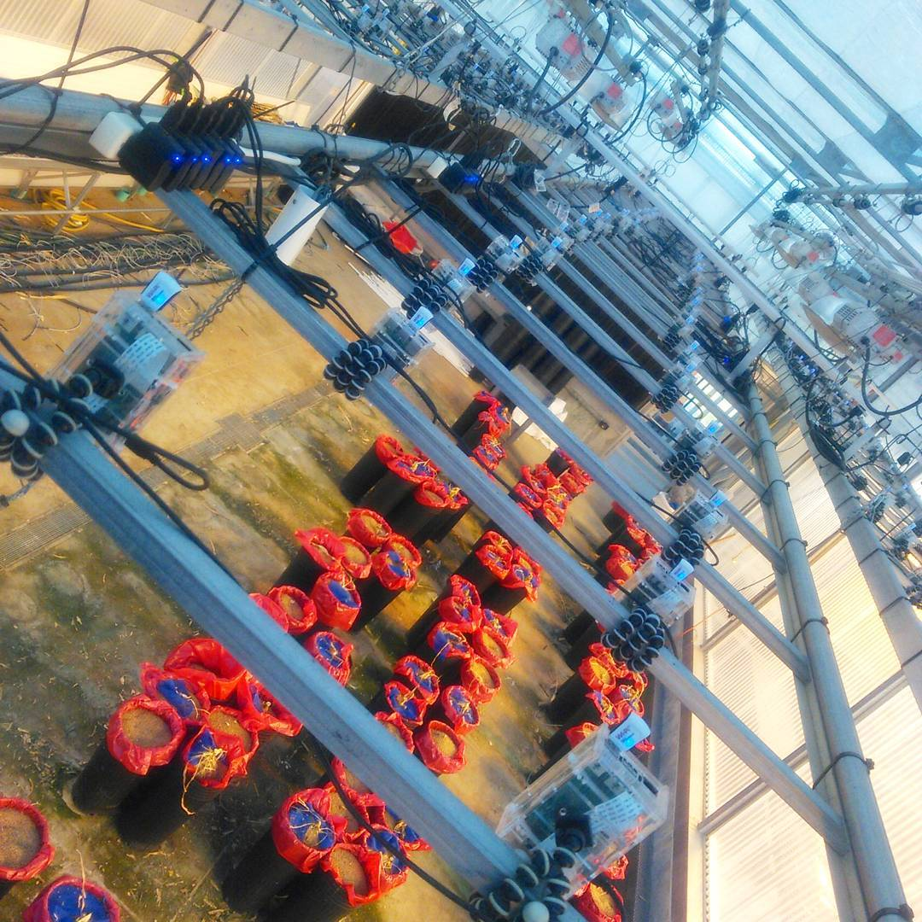
EPSCoR Greenhouse 9C
Summary:
180 Raspberry Pi bramble above GH9C on a gantry in a grid formation.
Goal: Capture and pull images autonomously then analyze pictures for phenotypic traits of plants in the greenhouse.

Slide 2

Previous Efforts
Physical & Hardware:
All Raspberry Pis placed on overhead gantry in a grid formation
Power strips with adapters and USB cables connected to Raspberry Pis
USB cable is Micro to Type A
Very similar (almost identical) to most Android smartphone chargers
Power adapter for Raspberry Pi provides exactly 5V, 1A
WiFi Dongles attached for internet access
Initially, Adafruit dongles used for the Raspberry Pi
Changed to Element14 WiPi dongles because of WiFi issues
More powerful signal and ability to hold a signal connected longer

Slide 3
Current Efforts
Physical & Hardware:
The power strips and cables have remained the same, however, Stuart has made sure the power cables don’t have any loops to reduce electromagnetic interference
WiFi dongles remain the same as the Element14 WiPi
Stuart is changing the angle of the cameras in order to increase the resolution of the 3D reconstruction

Slide 4
Previous Efforts cont.
Software & Management:
Raspberry Pi used Debian Wheezy (Raspbian version)
Quadrants of Raspberry Pis would reboot at scheduled times
Ganglia installed on all the Raspberry Pis to have an overview of the bramble with a 5-second delay
Any change to the bramble required changing each and every Raspberry Pi manually
The scheduled reboots would cause management to be unduly difficult
Pictures taken using cronjob on each Raspberry Pi independent of internet access
Pictures pushed to the infrastructure by each Raspberry Pi also using cronjobs.
Aside from files appearing on the infrastructure, no way to know how a file failed or if it failed to transfer

Slide 5
Current Efforts cont.
Software & Management
Raspberry Pi now have Debian Jessie (Raspbian version)
Raspbian has been integrated into the proper Linux branch making it a less experimental and more stable Linux OS with access to all the proper drivers
All Raspberry Pis remain on at all times.
Ganglia reinstalled on Raspberry Pis. All rPIs report to serverpi
Pictures taken with cronjob on each of the Raspberry Pi independent of internet access
Pictures pulled onto the infrastructure from each Raspberry Pi using a cronjob on chronos (DDPSC rsync server)
Logs kept from each job when pulled from the bramble
Using a deployment configuration engine called Ansible to manage the Raspberry Pi bramble from chronos
Doesn’t require specialized setup on the Raspberry Pis aside from Python 2.7+ and ssh
Can be installed via package manager or GitHub on the centralized server allowing for installation without administrator privileges

Slide 6
WiFi Issues
The majority of the problems with the system stem from connection to each Raspberry Pi for either short time spans or the amount of time it takes to transfer a file
WiFi interference is the main cause of these issues
There are numerous wireless access points (WAPs) stationed in and around the greenhouse that cause interference as well as the 180 rPIs themselves causing interference issues
Current solutions to WiFi interference:
We have two extra WAPs and four SSIDs being used exclusively for the bramble that stop the Raspberry Pis being dropped from the network
The new WiFi dongles also help with stability of connection and ability to establish a connection
Decrease transmit power from each Raspberry Pi until it’s time to transfer files then up the transmit power for the duration of transfer time
Possible solutions to WiFi interference:
As recommended by IT, wire every Raspberry Pi to a switch that is directly connected to the internet
No WiFi, no interference
Halfway wire the Raspberry Pis, six at a time to a wireless bridge bringing the number of devices connected to each SSID/WAP to around 8 per SSID instead of 45 per SSID
If each Raspberry Pi has to be wireless and not just the entire system, then we can get WiFi dongles with directional antennas

Slide 7
WiFi Issues cont.
In order to reduce the amount of data transferred between the Raspberry Pis and the centralized server:
Removed reverse DNS lookup in SSH
SSH authorization is assumed to be correct instead of verified
All the Raspberry Pi IP addresses are assumed to be the correct ones and given to the correct machines
UTMP is disabled on the Raspberry Pis
Enabled ControlMaster for SSH which keeps an established connection open so multiple commands can use the same connection
RSH can be used, but is more insecure than SSH even with all the previous changes

Slide 8
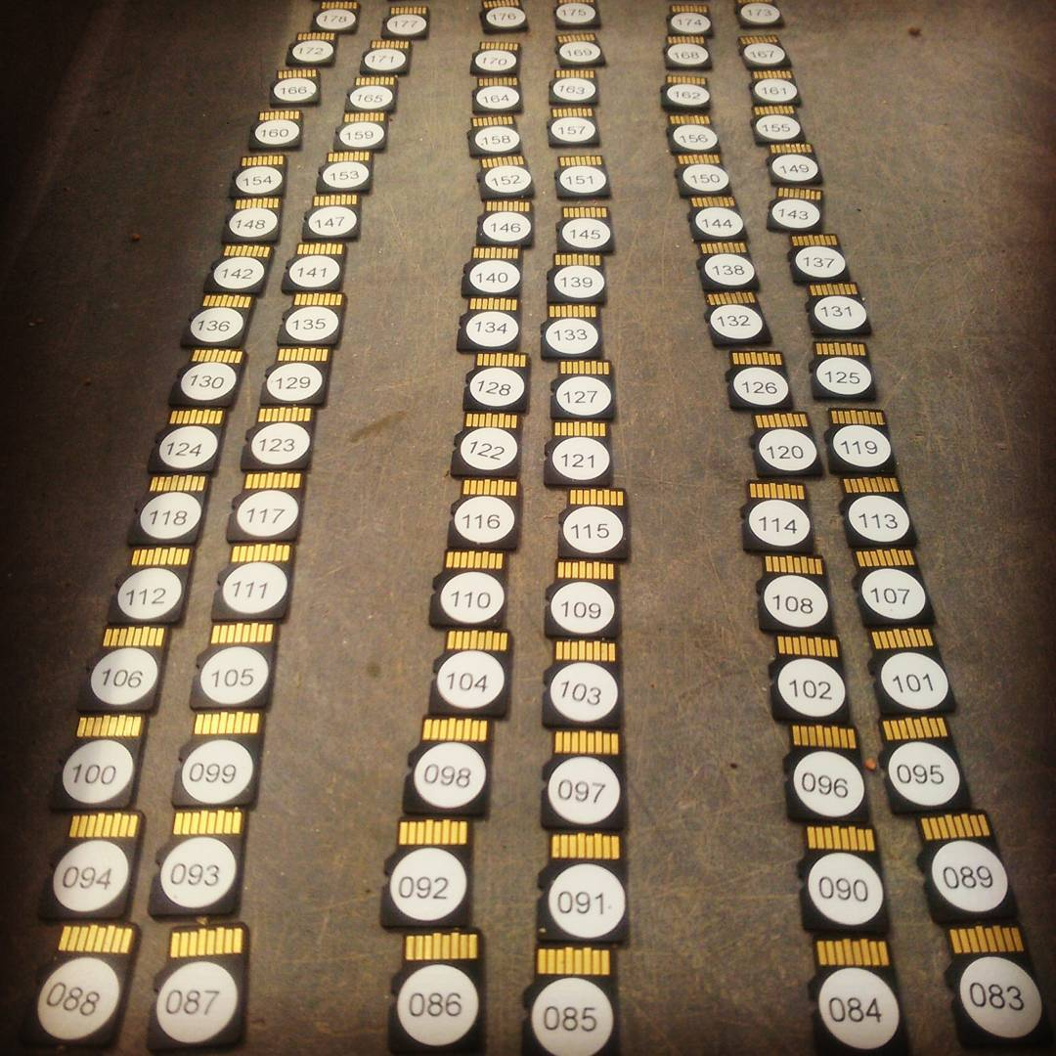
SD Cards: Labeled!

Slide 9
Management of Raspberry Pi bramble
To manage the bramble, Ansible needs a list of host names or IP addresses
All of the rPIs have been given static IP addresses ranging from 10.9.0.11 to 10.9.0.190
They are spaced out in a grid pattern and given their IP addresses in that order.
The IP addresses are also translated into grid matrix coordinates (2D array instead of 1D array coordinates)

Slide 10
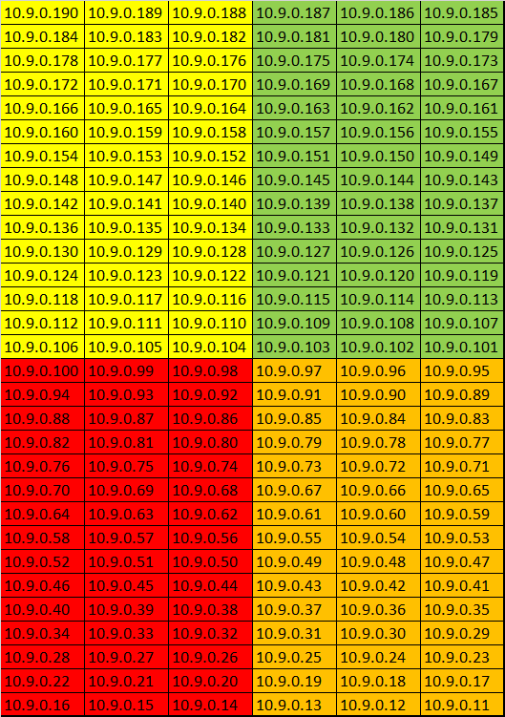
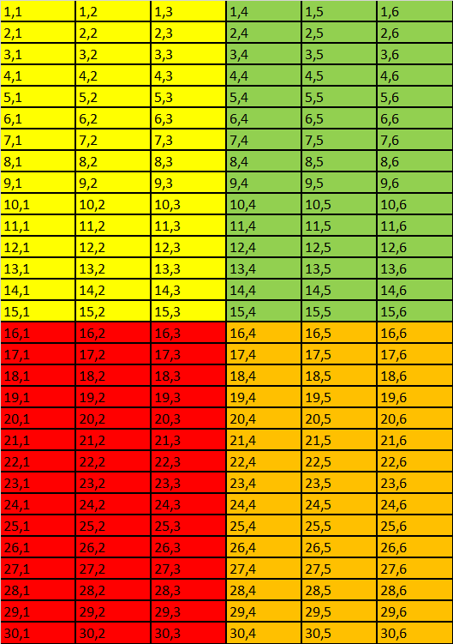
Raspberry Pi Bramble: Octet and Grid Forms

Slide 11
Management of Raspberry Pi bramble
Ansible uses playbooks to execute plays that are then executed on all or a limited number of hosts
I made several playbooks to handle:
Taking test pictures
Copying pictures from the bramble
Transferring the picture taking python script
Changing all of the SSH options (and reverting changes)
A full documentation of the process from initial SD cards to fully setup Ansible management can be found at my github:
https://github.com/calizarr/EPSCoR_Bramble_GH9C/

Slide 12
Adding GPS units to images
During the 3D reconstruction process, we found out that VisualSFM can use GPS data.
I chose a spot in Greenhouse 9C found its GPS coordinates, measured the distance from the spot to ShakoorCamera145.
Using ShakoorCamera145 as an origin, I used QGIS and PyQGIS to reconstruct the positioning of the bramble as a matrix
Stuart measured the corners of the greenhouse and found their coordinates as well as the distance from the northeast corner to ShakoorCamera21
Reconstructed bramble as matrix using ShakoorCamera21 as the origin.
Still a work in progress, but it should allow the 3D reconstruction to use real units when scaling and therefore allow us to measure items in the reconstruction

Slide 13
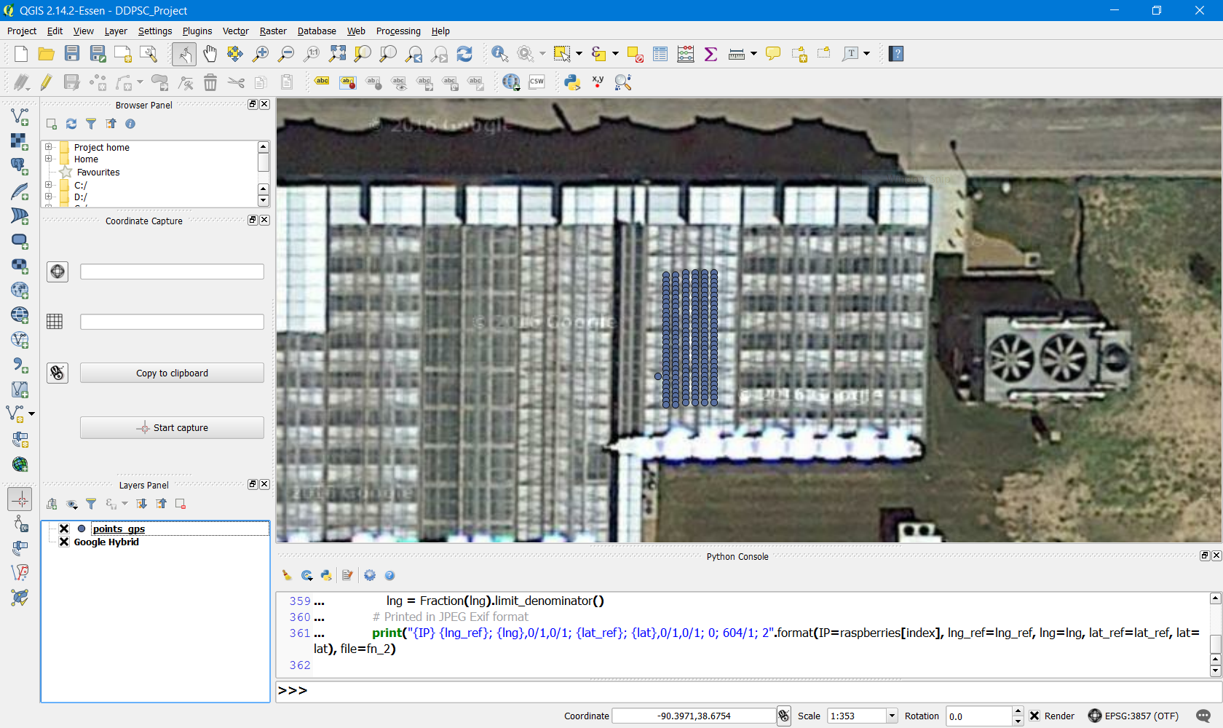
QGIS Overlay (Google Maps Hybrid)

Slide 14
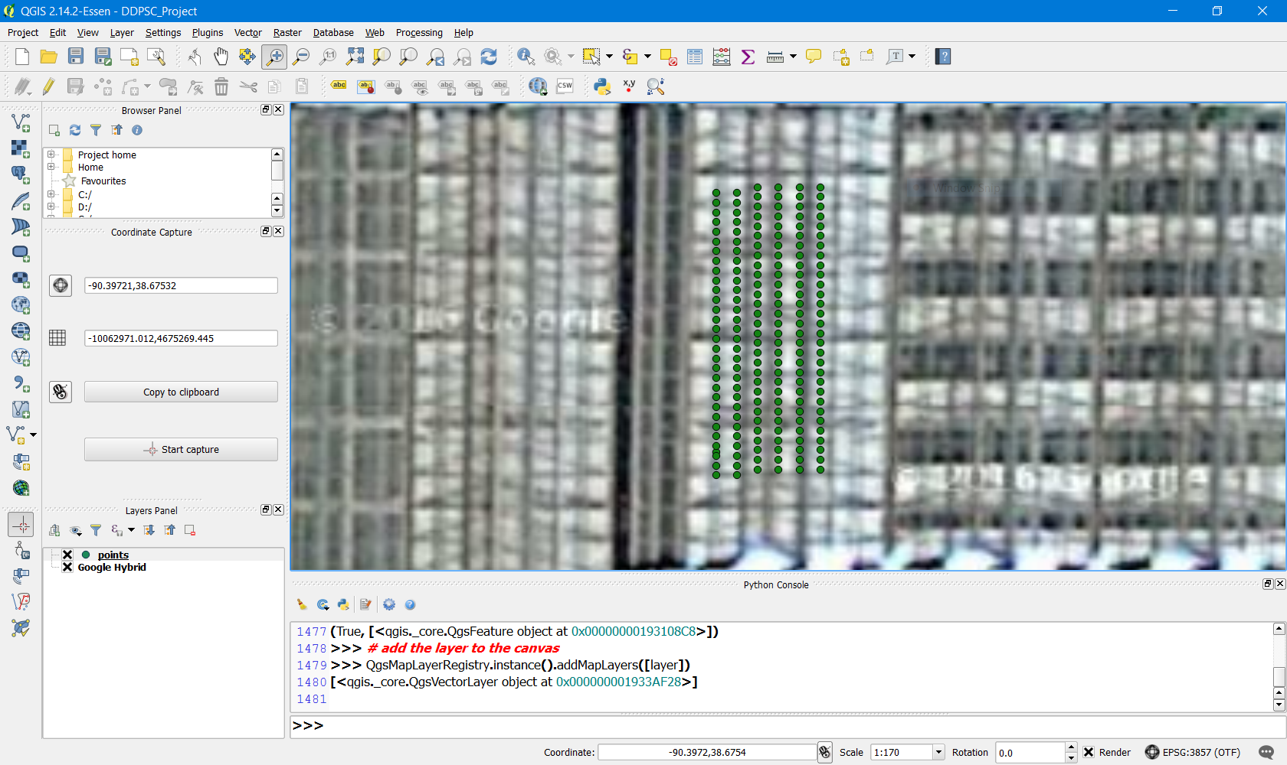
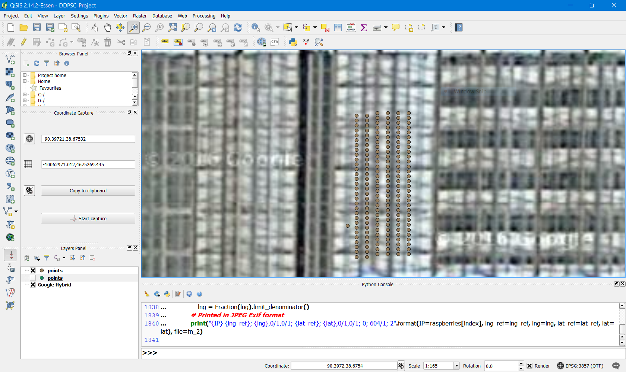
Raspberry Pi Cluster On QGIS
Stuart’s Coordinates
César’s Coordinates

Slide 15
Results
165 Raspberry Pis are consistently reporting and establishing connections. Between 170-172 occasionally establish connection
Initial 3D reconstructions exist and as camera positions and angles are finalized, we keep improving them
Fully documented process

Slide 16
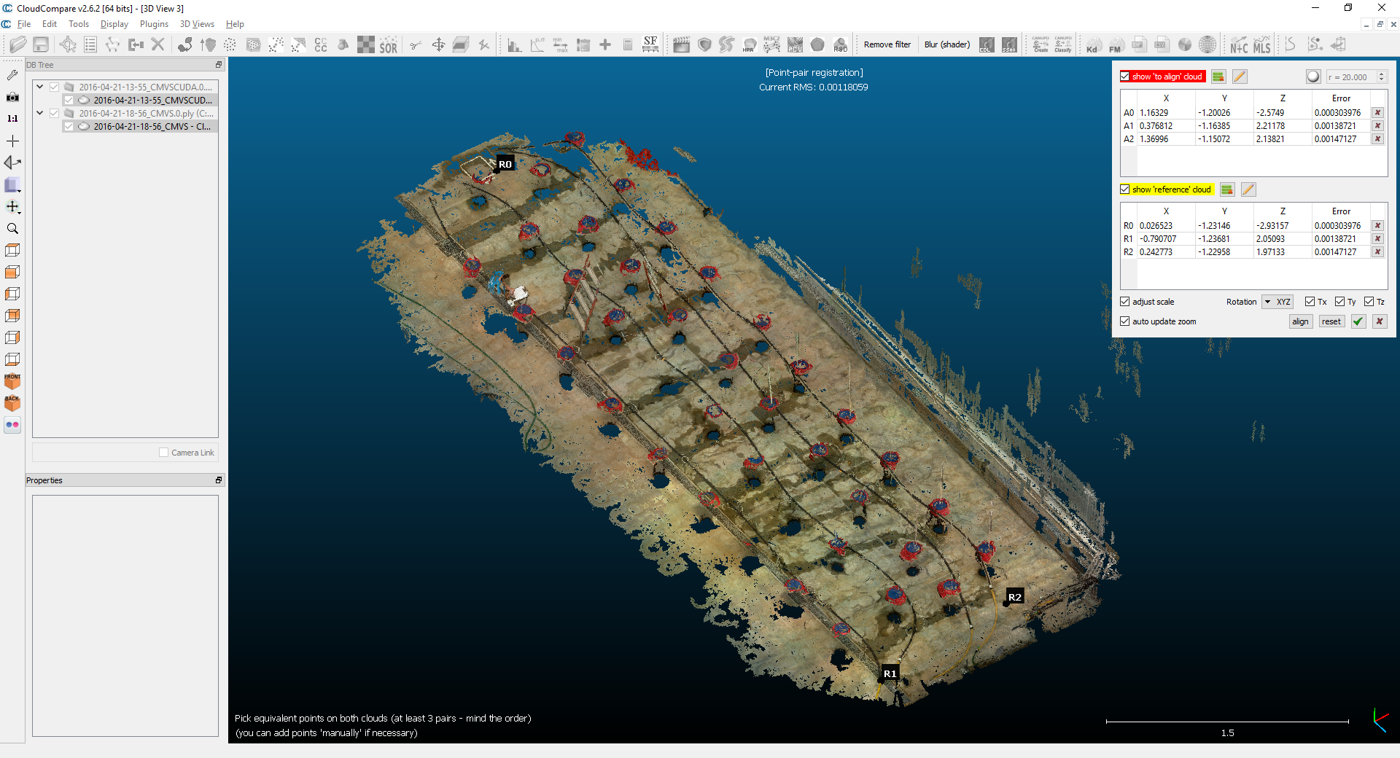
3D Reconstruction

Slide 17
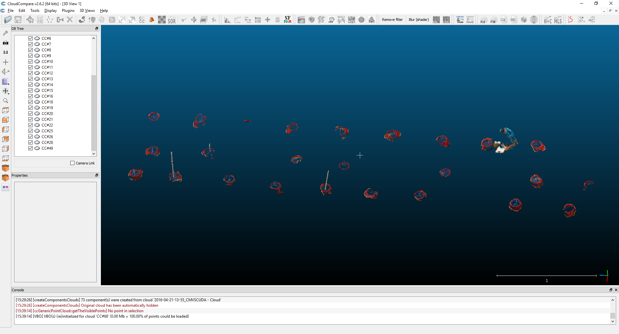
3D Reconstructions: Connected Components

Slide 18
Next Steps
Adding GPS units to image files to aid in 3D reconstruction
Also have proper units and scale for the 3D reconstruction
Finalize camera angles and positions to improve 3D reconstruction
Set the bramble to run autonomously
Take 3D reconstruction point cloud and analyze subsections (plants) to extract phenotypes

